Slide 1




Human Rights
Project: „Climate is a topic!!!” 2019-1-PL01-KA229-064863
Erasmus+
Cooperation for innovation and the exchange of good practices
KA229 - School Exchange Partnerships

Slide 2

What are Human Rights?

Slide 3
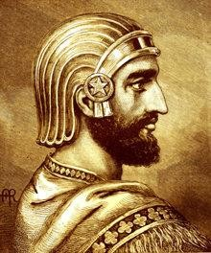
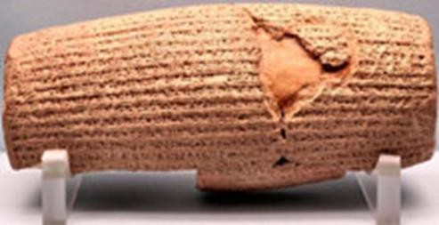
A Brief History of Human Rights
Cyrus the Great, known today as the Cyrus Cylinder the first king of Persia, freed the slaves of Babylon, 539 B.C
From Babylon, the idea of human rights spread quickly to India, Greece and eventually Rome. There the concept of “natural law” arose, in observation of the fact that people tended to follow certain unwritten laws in the course of life, and Roman law was based on rational ideas derived from the nature of things.

Slide 4

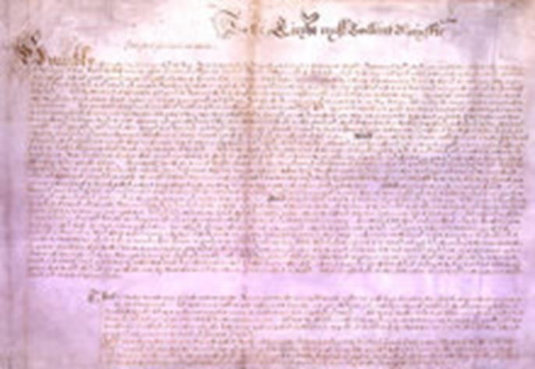
A Brief History of Human Rights
Documents asserting individual rights, such as:
The Magna Carta (1215)
The Petition of Right (1628)
The US Constitution (1787)
The French Declaration of the Rights of Man and of the Citizen (1789)
The US Bill of Rights (1791)
The First Geneva Convention (1864)
The Universal Declaration of Human Rights (1948)
Magna Carta, or “Great Charter,” signed by the King of England in 1215, was a turning point in human rights.
In 1628 the English Parliament sent this statement of civil liberties to King Charles I.

Slide 5



Following the French Revolution in 1789, the Declaration of the Rights of Man and of the Citizen granted specific freedoms from oppression, as an “expression of the
general will.”
The original document from the first Geneva Convention in 1864 provided for
soldiers.
The Bill of Rights of the US Constitution protects basic freedoms of United States citizens.
A Brief History of Human Rights

Slide 6
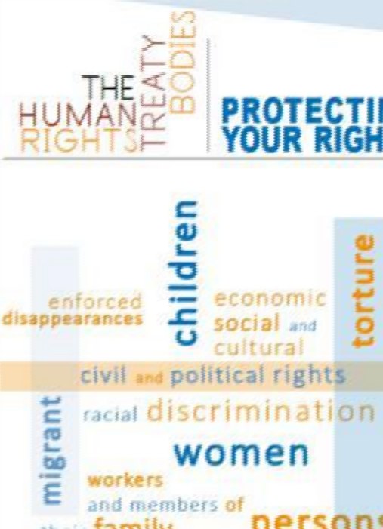
Human rights : International documents
Two of the key values that lie at the core of the idea of human rights are human dignity and equality.
1948 The principle of universality of human rights is the cornerstone of international human rights law : The Universal Declaration of Human Rights (UDHR)
1998 Treaty – known as the Rome Statute of the International Criminal Court
– establishing the International Criminal Court. The treaty entered into force
on 1 July 2002.
2016 Resolution 32/33 adopted by the Human Rights Council : Human rights and climate change
1950 Adoption of the Convention, 1953 Entry into force of the Convention : Treaty under which the member States of the Council of Europe promise to secure fundamental civil and political rights : European Convention on Human Rights.
1959 European Court of Human Rights . It rules on individual or State applications alleging violations of the civil and political rights set out in the European Convention on Human Rights.
2009 Resolution 1655, Environmentally induced migration and displacement 2009 Recommendation 1883, Challenges posed by climate change
2009 Recommendation 1885, Protocol to the European Convention on Human Rights
concerning the right to a healthy environment.

Slide 7

The United Nations and Human Rights
On December 10, 1948, the General Assembly adopted the Universal Declaration of Human Rights. It is a document that identifies the most important things that every person on the planet needs to lead a normal and dignified life. It contains 30 rights, each of which meets a human need.

Slide 8
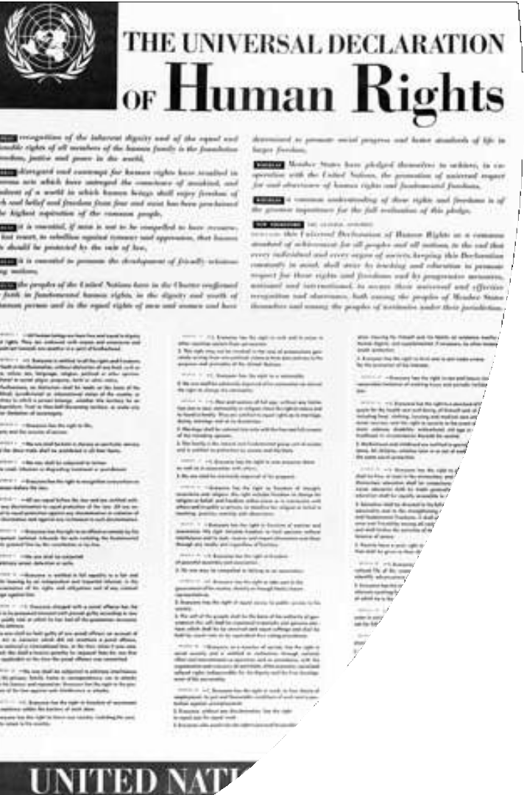
Universal Declaration of Human Rights
Article 25
1. Everyone has the right to a standard of living adequate for the health and well-being of himself and of his family, including food, clothing, housing and medical care and necessary social services, and the right to security in the event of unemployment, sickness, disability, widowhood, old age or other lack of livelihood in circumstances beyond his control.
1. Motherhood and childhood are entitled to special care and assistance. All children, whether born in or out of wedlock, shall enjoy the same social protection.

Slide 9
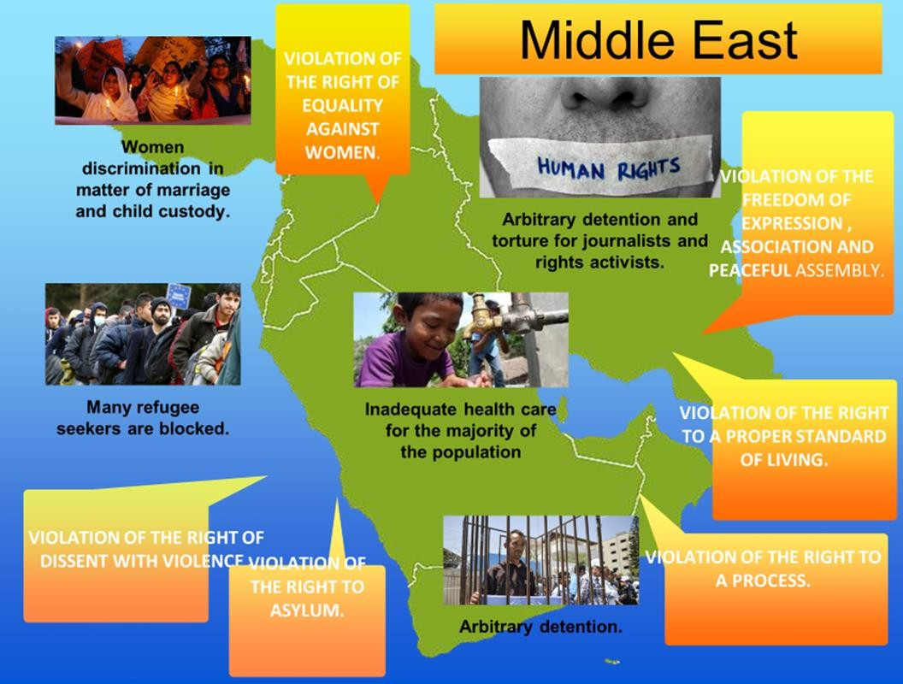

Slide 10
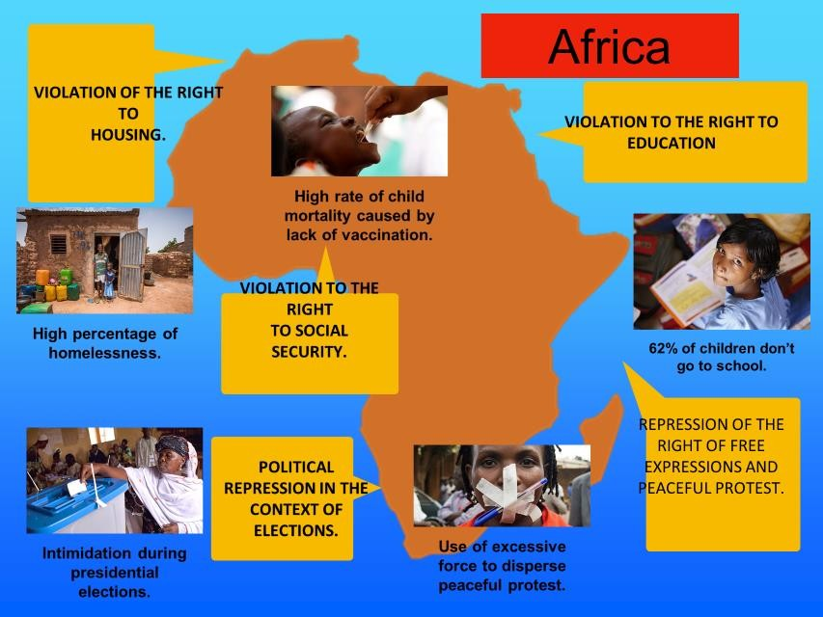

Slide 11
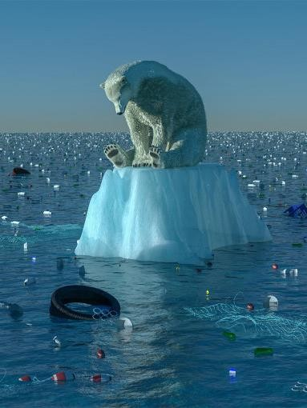
Human Rights and climate change
Human Rights and Climate Change is a conceptual and legal framework under which international human rights and their relationship to global warming are studied, analyzed, and addressed. Most international statements on human rights and climate change have emphasized the potential adverse impacts of climate change on the rights to life, food, water, health, housing, development, and self-determination. These rights are enumerated in the core conventions of international human rights law.
2005 - Inuit activist Sheila Watt-Cloutier filed a petition to the Inter- American Commission on Human Rights seeking relief "from human rights violations resulting from the impacts of global warming and climate change caused by acts and omissions of the United States.
2005 - the Malé Declaration on the Human Dimension of Global Climate Change "stated explicitly (and for the first time in an international agreement) that 'climate change has clear and immediate implications for the full enjoyment of human rights
2006 - the UN Human Rights Council (HRC) unanimously adopted Resolution 7/23, recognizing that "climate change poses an immediate and far-reaching threat to people and communities around the world and has implications for the full enjoyment of human rights,"
2009 - The HRC reaffirmed and expanded these statements with resolutions 10/4 of 25 March 2009 and 18/22 of 30 September 2011
2015 - United Nations Climate Change Conference in Paris: the most important indication of increasing awareness towards the relationship between climate change and human rights. The Paris Agreement is the first climate agreement to recognise the relevance of human rights, stating
2016 – Resolution 32/33: Human rights and climate change
Photo: https://www.adamgavin.com/blog/an-introduction-to-climate- change

Slide 12


Erasmus+
Cooperation for innovation and the exchange of good practices KA229
School Exchange Partnerships
The presentation was prepared by teams from Poland, France, Greece, Bulgaria, Belgium and Italy as part of the project implementation: "Climate is a topic !"
2019-1-PL01-KA229-064863
Source and photos: https://www.twenty20.com/photos/

