Slide 1



LEARNING ABOUT CLIMATE CHANGE
PROJECT: „CLIMATE IS A TOPIC!!!” 2019-1-PL01-KA229-064863 ERASMUS+ COOPERATION FOR INNOVATION AND THE EXCHANGE OF GOOD PRACTICES
KA229 - SCHOOL EXCHANGE PARTNERSHIPS

Slide 2
HOT ON THE PLANET

Slide 3

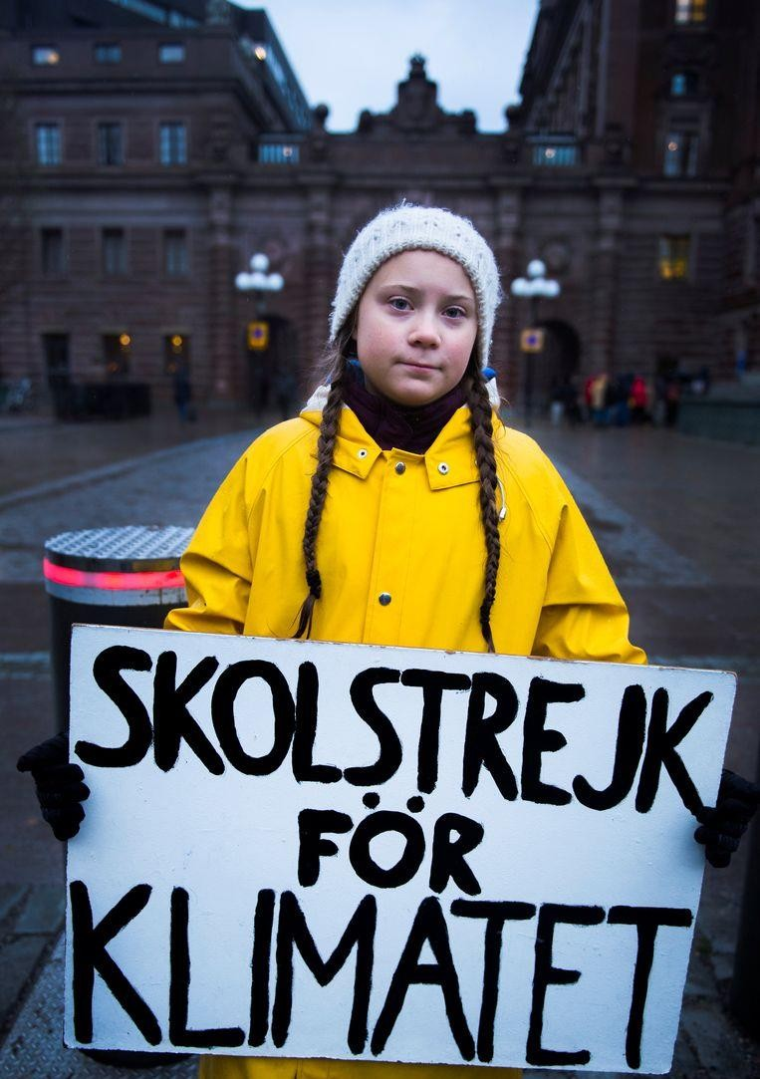
YOUTH FOR CLIMATE
August 20, 2018
Greta:
I think I will not be going to school this year…
There are more important things in the
in life…
Are you sure? Very sure!
You know, as a father I cannot approve this… I know…
world and Father: Greta: Father: Greta:
Father embraced his daughter and whispered: As a
person, I am completely behind you!
Greta took her backpack and walked to the parliament building. Since then she has been there every day.
The rest is history…

Slide 4
ENVIRONMENT VS CLIMATE
THE ENVIRONMENT IS THE ENVIRONMENT IN WHICH WE ALL LIVE.
THE SOIL, THE SKY, THE TREES, ... EVERYTHING AROUND US
THE CLIMATE IS THE AVERAGE WEATHER OVER A 30-YEAR PERIOD.
SO THE CLIMATE IS SOMETHING VERY DIFFERENT FROM THE WEATHER,

Slide 5
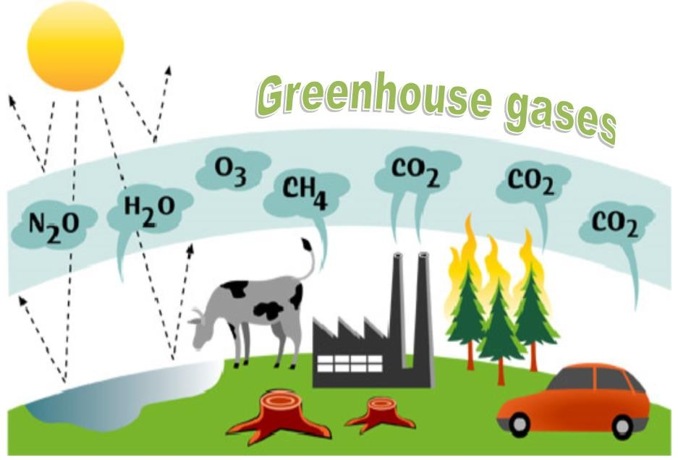

Slide 6
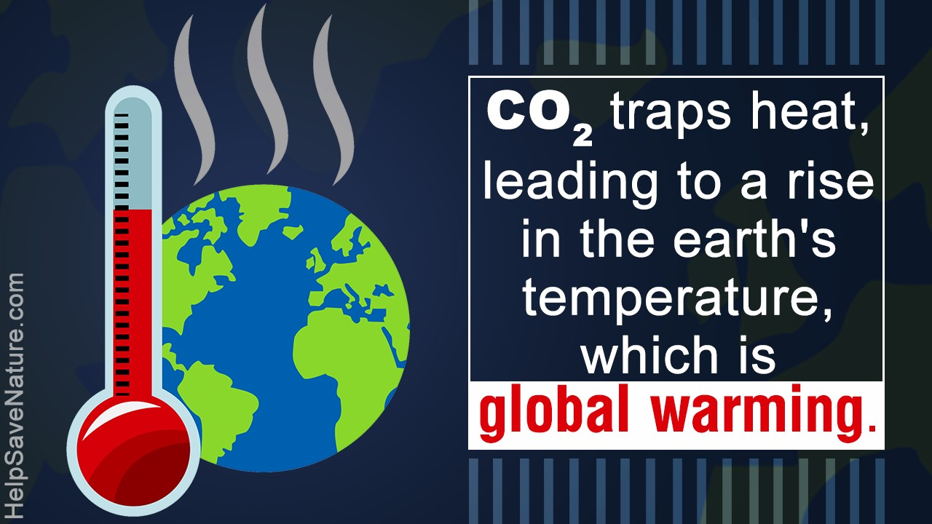
AN INCREASE IN CARBON DIOXIDE (CO2) IN THE ATMOSPHERE, CAUSES AN INCREASE IN GLOBAL TEMPERATURE

Slide 7
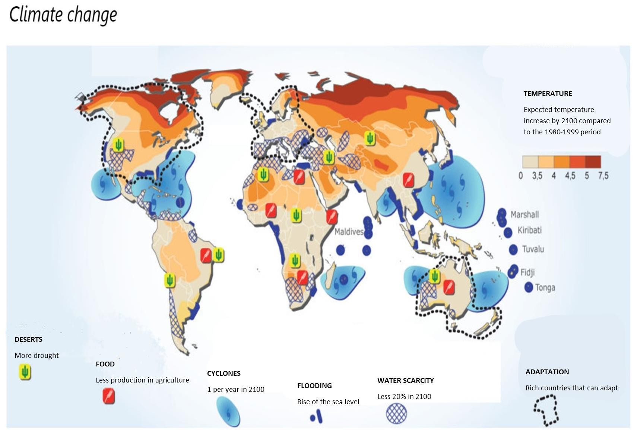

Slide 8
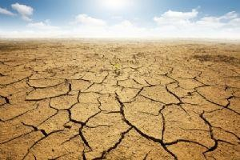

Slide 9
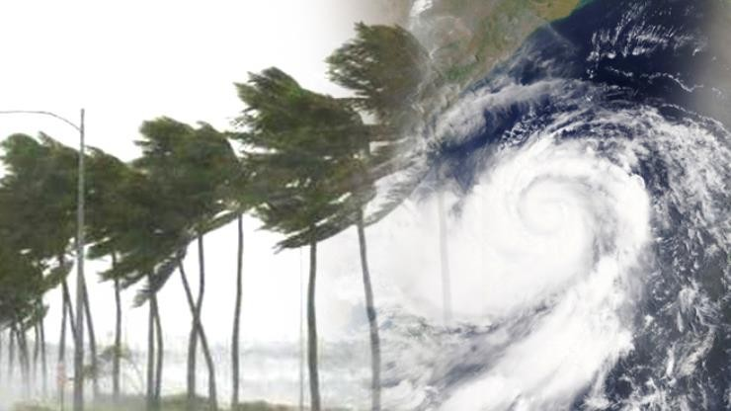

Slide 10
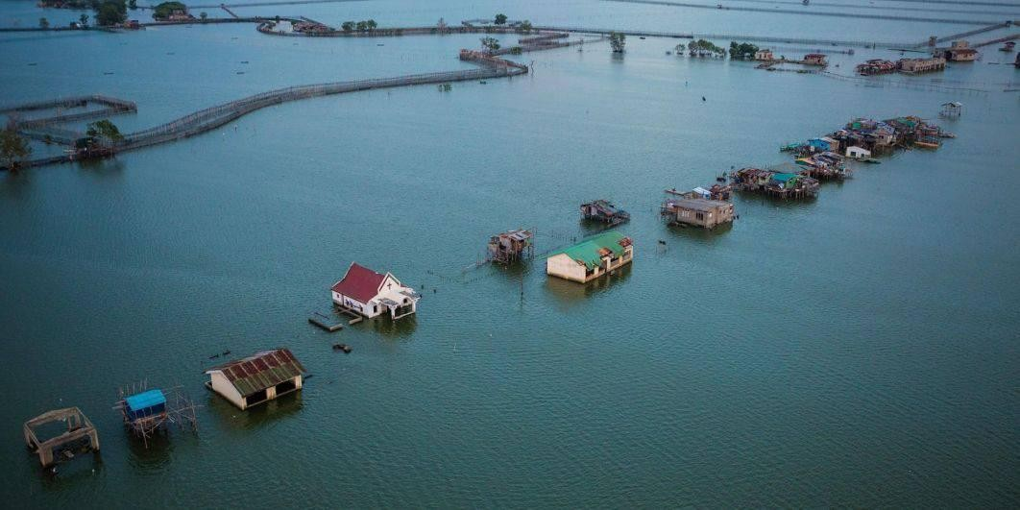

Slide 11


WHAT CAN WE DO TO REDUCE CO2 EMISSIONS?

Slide 12
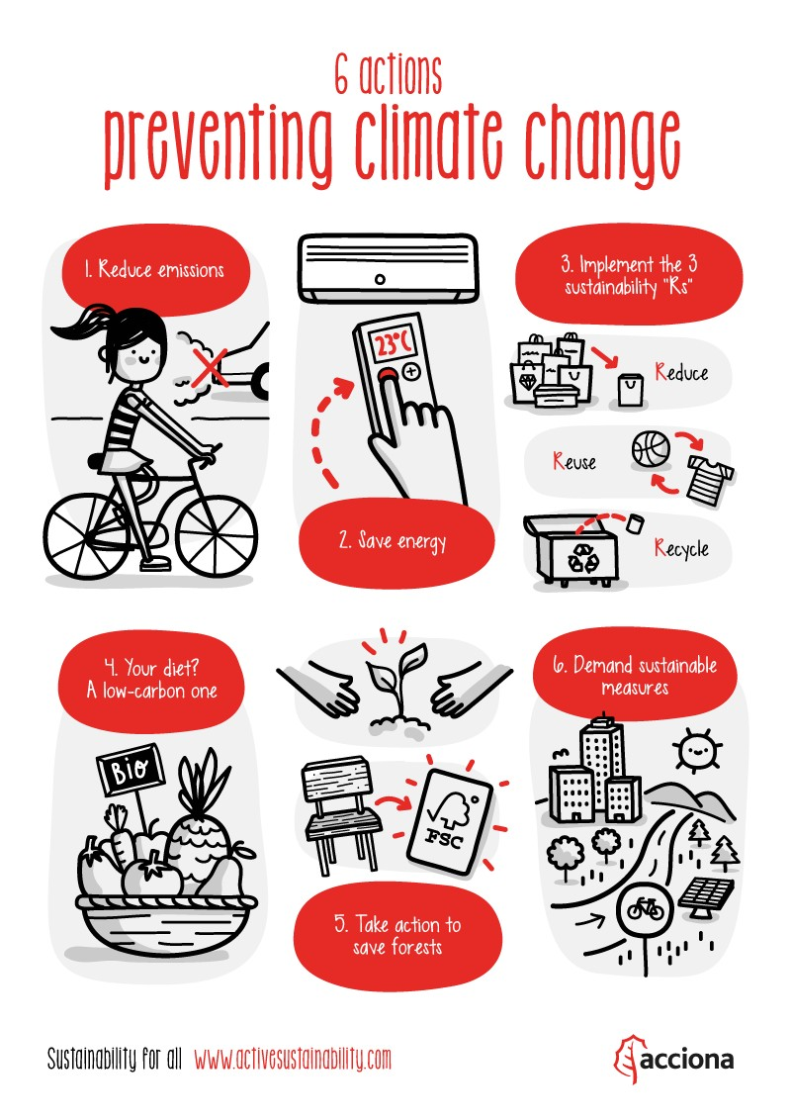

Slide 13


ERASMUS+ COOPERATION FOR INNOVATION AND THE EXCHANGE OF GOOD PRACTICES KA229 SCHOOL EXCHANGE PARTNERSHIPS
THE PRESENTATION WAS PREPARED BY BELGIAN TEAM AS PART OF THE PROJECT IMPLEMENTATION:
"CLIMATE IS A TOPIC !" 2019-1-PL01- KA229-064863
Source and photos: https://www.twenty20.com/photos/

