Slide 1


Bilingual Primary School No. 1 in Warsaw, Poland
Dwujęzyczna Szkoła Podstawowa nr 1 w Warszawie, Polska

Slide 2

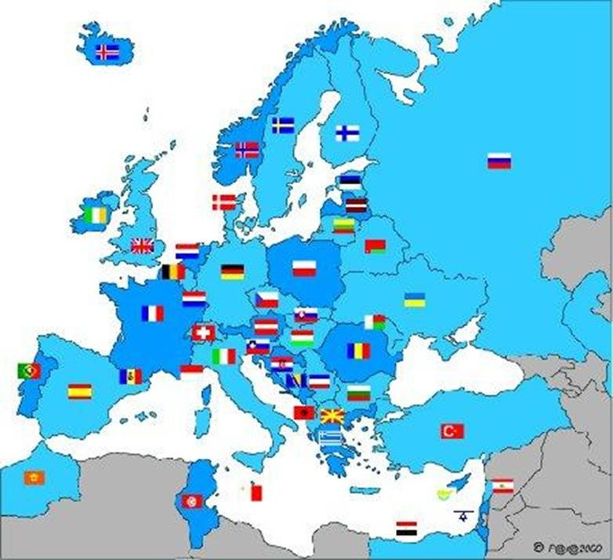
Bilingual Primary School No. 1 in Warsaw, Poland
The Republic of Poland in Europe
Photo: Wikipedia

Slide 3
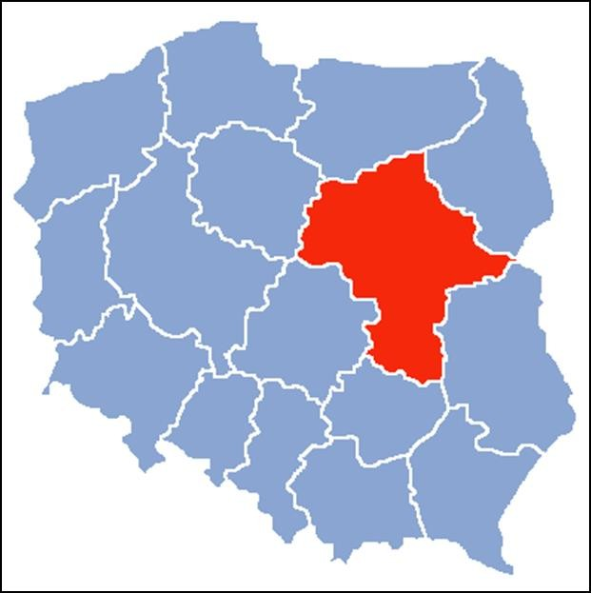
Bilingual Primary School No. 1 in Warsaw, Poland
Warsaw
Mazovia – our region

Slide 4
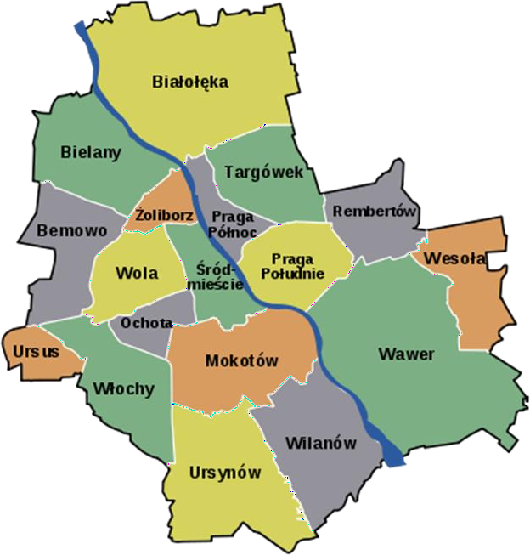

Bilingual Primary School No. 1 in Warsaw, Poland
Vistula River
Warsaw, the capital city of Poland and its districts

Slide 5
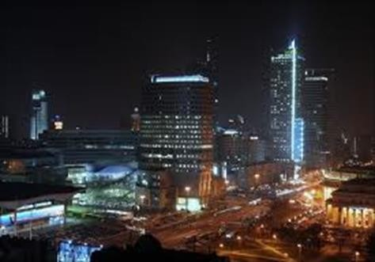
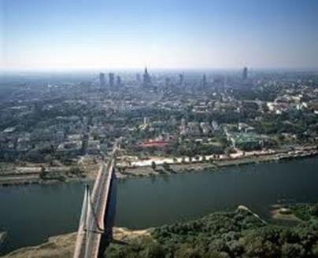
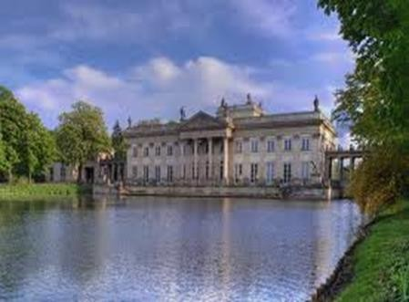
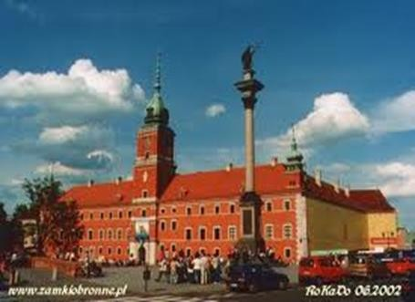
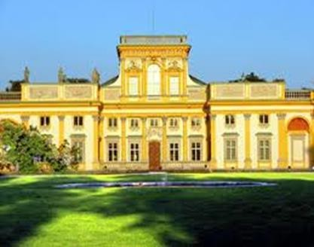
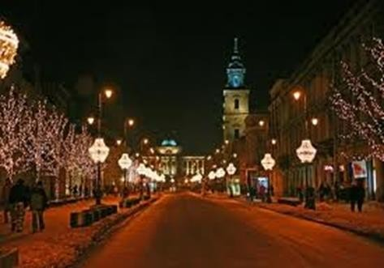
Bilingual Primary School No. 1 in Warsaw, Poland
Warsaw – capital of the Republic of Poland

Slide 6
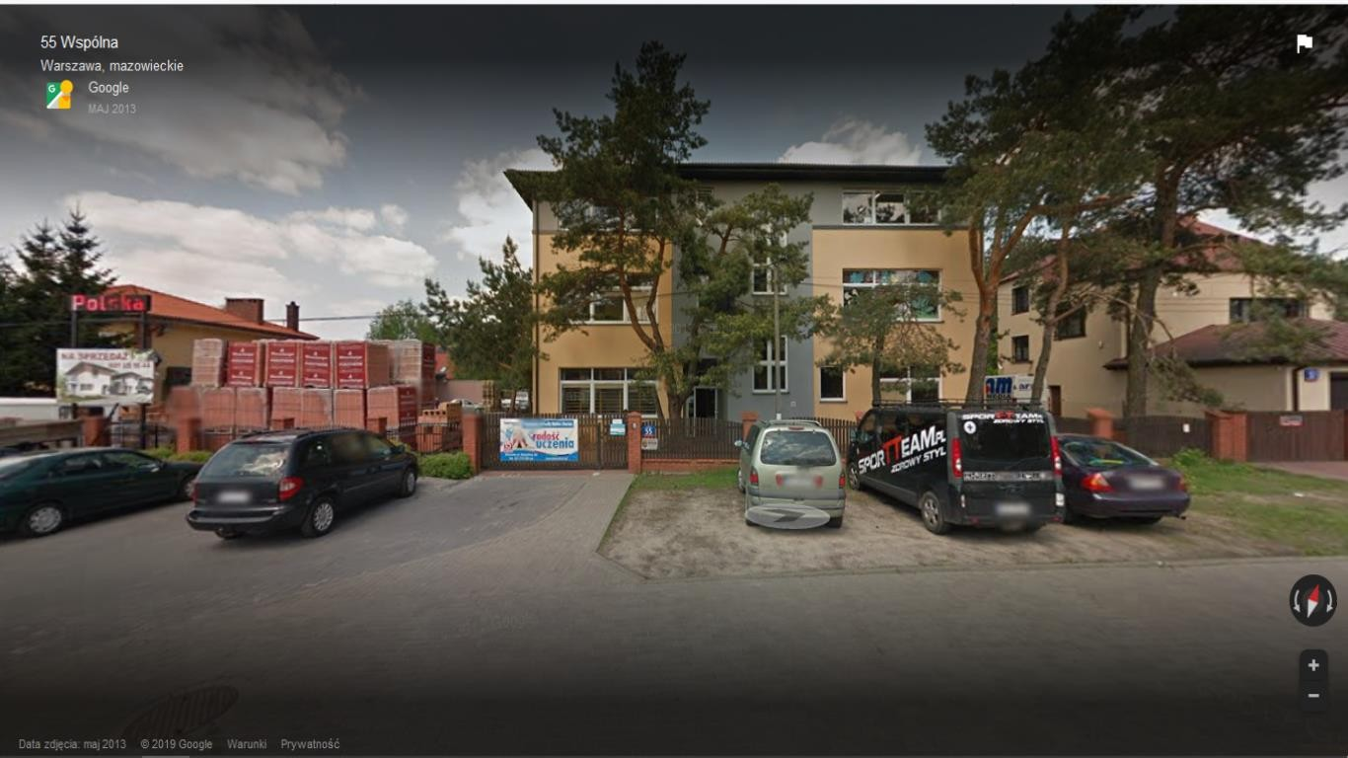
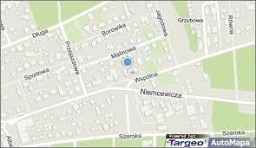
Bilingual Primary School No. 1 in Warsaw, Poland
Photo: Google maps

Slide 7

Bilingual Primary School No. 1 in Warsaw, Poland
Our school was founded in 2009 by Ms. Anna Zalewska-Lipka, President of Bilingual Education Fundation, Amaltea. From its birth, the school is located in the beautiful, green district of Warsaw: Wesoła, surrounded by forests.
With 185 pupils and 40 teachers we are not a large school. An important part of the school’s strategy is education within integrated content and areas of subjects taught in English, teaching other foreign languages and use of innovative technologies and digital tools, as well as new methods and techniques of motivation.
While learning in our school kids can develop their various passions and
hobbies such as: music, drama, art, maths, languages, science.

Slide 8

Bilingual Primary School No. 1 in Warsaw, Poland Environmental Protection
Earth Day is an annual event celebrated in our school on April 22 to demonstrate support for environmental protection.

Slide 9
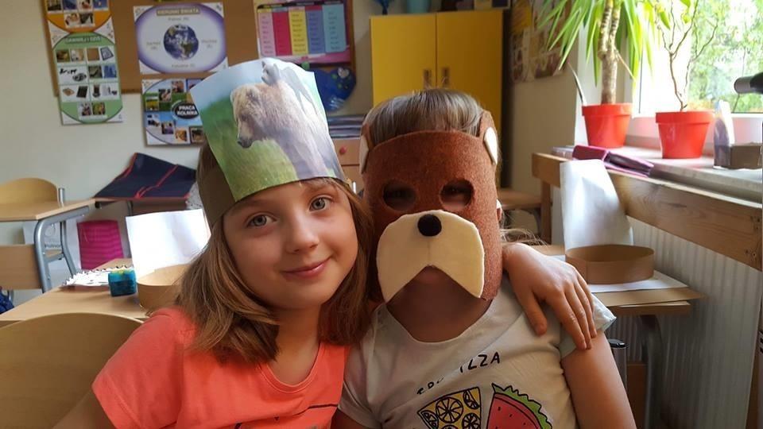
Bilingual Primary School No. 1 in Warsaw, Poland Environmental Protection
Action: About animal species under protection
Photo: A. Boguszewska

Slide 10
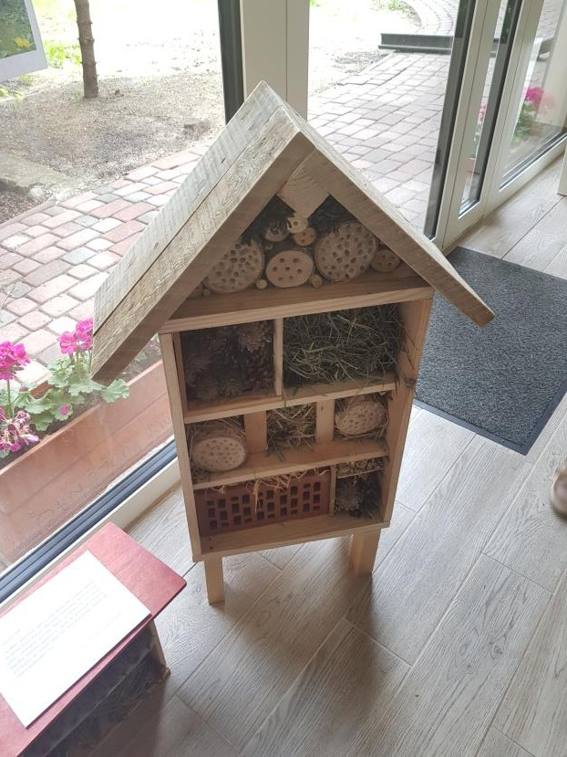
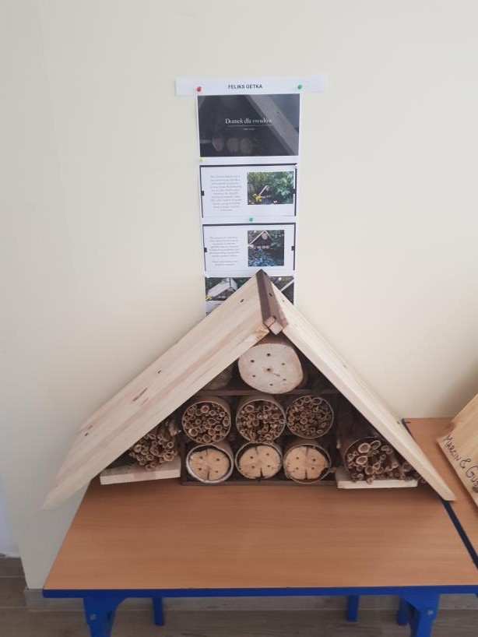
Bilingual Primary School No. 1 in Warsaw, Poland Environmental Protection
Action: Insect feeders

Slide 11
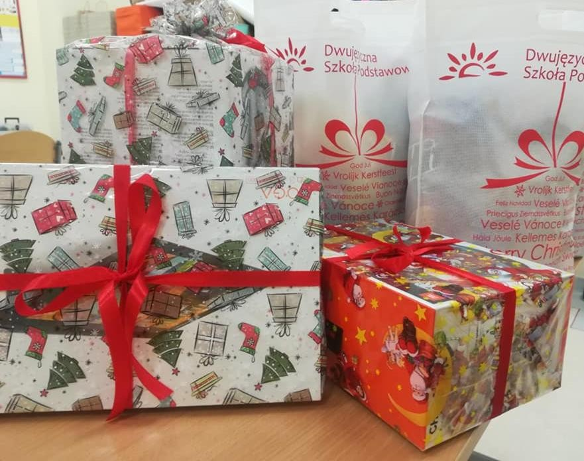
Bilingual Primary School No. 1 in Warsaw, Poland Voluntary
In our school there are various voluntary actions: helping older people, kids, families and animals

Slide 12
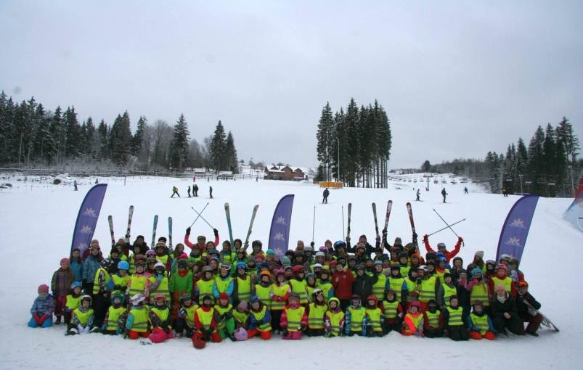
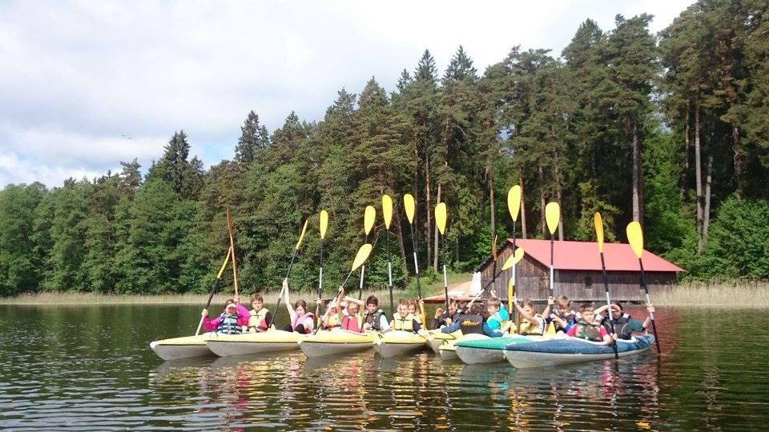
Bilingual Primary School No. 1 in Warsaw, Poland Green School and White School
In Spring, our school organizes an annual trips called Green School. During the Green School students live in a hotel and visit the most interesting places in a region. During the White School, in Winter time, students live in a hotel, too, and train skiing or snowboarding.
Photo:. Z. Skibińska

Slide 13



Bilingual Primary School No. 1 in Warsaw, Poland PROJECTS
Coding Masters - Is a program for students who want to deepen their knowledge in the field of programming.
Through the stomach to languages -
The project is related to language skills : French, English, Spanish. Students can learn new vocabularies.
Fruits and vegetables at school - The project supporting healthy eating has been introduced in our school.
Loga projektów: www.dwujezycznaszkola.pl

Slide 14



Bilingual Primary School No. 1 in Warsaw, Poland PROJECTS
Wars and Sawa is a project supporting and appreciating the effort and talents of students.
GRADUATE INDUSTRY is a modern project in the field of mathematics, natural science, technical and computer classes.
Erasmus+Educational Staff mobility. Project „Towards better quality and modernity” is dedicated to raise quality of education and international cooperation at the Bilingual Primary School nr 1 in Warsaw. Its main goal is to raise quality of education within integrated content and areas of subjects taught in English, teaching other foreign languages and use innovative technologies and digital tools, as well as new methods and techniques of motivation.

Slide 15

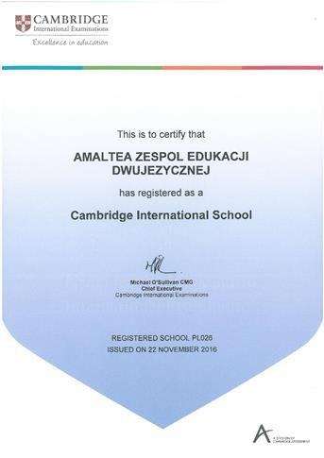
Bilingual Primary School No. 1 in Warsaw, Poland PROJECTS
Our school is registred as a Cambridge International School and
joined the Cambridge program for foreign primary schools.

Slide 16
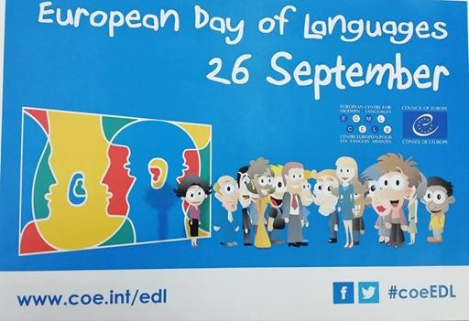

Bilingual Primary School No. 1 in Warsaw, Poland LANGUAGES
Most of the lessons at school are conducted in Polish and English. Teachers broaden students' knowledge through new vocabulary related to the subject and communicate with students in English so that children feel comfortable in communication in this language. Communication in different languages is very important, that's why our school offers a choice of Spanish and French to choose from.
For two years now our school has cooperated with a Spanish school: Sage College from Jerez de la Frontera. Once a year students from both schools meet to realise a joint project.

Slide 17
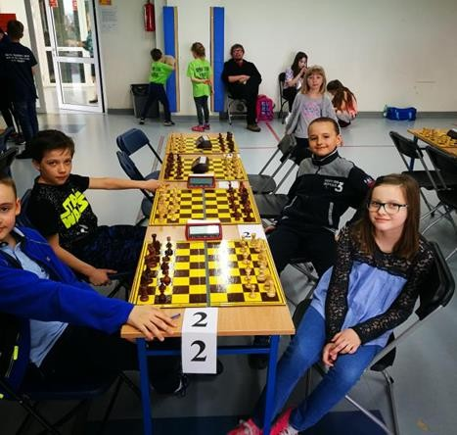
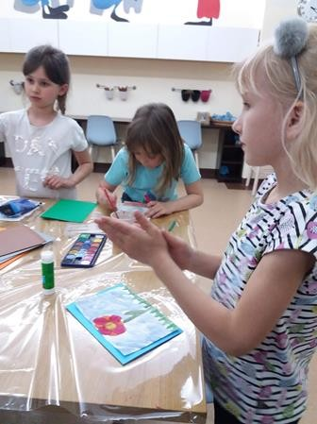
Bilingual Primary School No. 1 in Warsaw, Poland Extracurricular activities
In our school we have additional classes which are for everyone who wants to learn something new. We have, for example, extra chess and art classes. They are really important for students to improve their skills.
Photo: Z. Skibińska

Slide 18

Bilingual Primary School No. 1 in Warsaw, Poland
This presentation was prepared as part of the project: „Climat is a topic!!!” 2019-1-PL01-KA229-064863.
Program Erasmus+, Cooperation for innovation and the exchange of good practices, KA229 - School Exchange Partnerships

